Slide 1
GEOG0114: Principles of spatial analysis
WEEK 4: Suitability mapping (PART 1)
Dr Anwar Musah (a.musah@ucl.ac.uk)
Lecturer in Social and Geographic Data Science
UCL Geography
1

Slide 2
Contents
What is suitability analysis (or mapping)
Case study: LF transmission in Kenya
Principles for using Suitability Analysis
Binary and Score-based mapping for suitability
Analytical Hierarchy Process (AHP)
Methodology for performing AHP analysis
Standardization of raster risk factors to a single scale
Pairwise comparison
Matrix calculations for Normalization and estimation of weights
Weighted Linear Combination Model
Validation
4. Continuous Module Dialogue (CMD) survey
Problem
Knowledge
Collect
Model
Wrangle
Explore
2
Notes:
So today we will talk about these items i.e., timetable, assessment…

Slide 3

QUICK recap
Spatial dependence i.e., the degree for nearby objects in space tend to influence each other.
Spatial autocorrelation (spatial locations close to each other have similar or dispersed values)
Spatial heterogeneity (uneven distribution of observed values across space)
Spatial Weight Matrix accounted for explicitly in spatial analysis
Contiguity-based matrices i.e., Rooks, Queen and Bishop
Distance-based matrices
Statistical inference using Moran’s I test to measure the degree of spatial autocorrelation
Global Moran’s I statistic
Local Moran’s (LISA)
Let’s rewind a bit to last week (3),
and also, to Week 2
But in Week 2:
We learned about Raster/Gridded Data
Used for measuring outcomes that are non-discrete i.e., continuous across space
3
Notes:
Before we start, let’s recap on last week

Slide 4
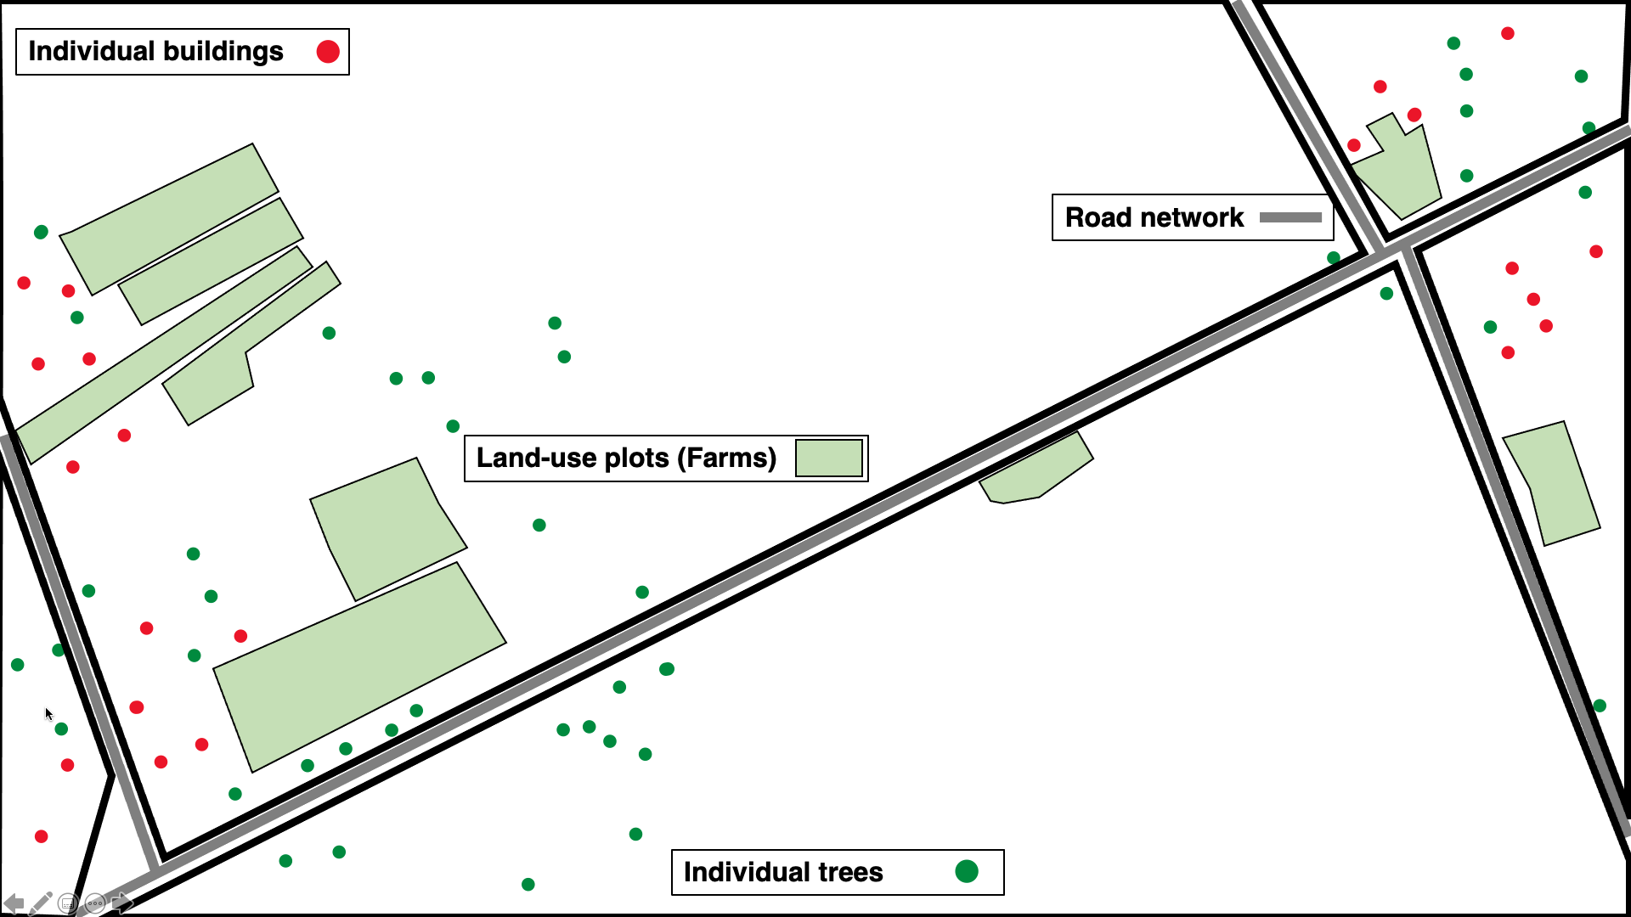
6 | 7 | 8 | 10 | 0 | 0 | 10 | 10 | 0 | 0 | 0 | 0 | 10 | 5 | 3 | 0 | 0 | 0 | 0 | 0
6 | 7 | 8 | 10 | 0 | 0 | 10 | 10 | 0 | 0 | 10 | 0 | 10 | 6 | 3 | 0 | 0 | 0 | 0 | 0
6 | 7 | 8 | 10 | 10 | 0 | 10 | 10 | 0 | 0 | 10 | 0 | 10 | 7 | 5 | 3 | 0 | 0 | 0 | 0
5 | 6 | 8 | 9 | 10 | 10 | 0 | 10 | 0 | 0 | 10 | 0 | 10 | 7 | 5 | 3 | 0 | 0 | 0 | 0
1 | 4 | 8 | 9 | 9 | 10 | 0 | 10 | 10 | 10 | 0 | 0 | 0 | 7 | 5 | 3 | 0 | 0 | 0 | 0
0 | 4 | 8 | 9 | 9 | 10 | 10 | 0 | 10 | 9 | 9 | 0 | 0 | 5 | 3 | 0 | 0 | 0 | 0 | 0
0 | 4 | 8 | 8 | 9 | 9 | 10 | 0 | 0 | 9 | 8 | 7 | 5 | 0 | 0 | 0 | 1 | 0 | 0 | 0
0 | 3 | 5 | 8 | 8 | 9 | 10 | 10 | 0 | 9 | 7 | 5 | 0 | 0 | 5 | 5 | 5 | 0 | 0 | 0
0 | 2 | 3 | 5 | 8 | 9 | 9 | 10 | 0 | 0 | 3 | 0 | 0 | 0 | 5 | 0 | 0 | 1 | 0 | 0
0 | 2 | 2 | 5 | 8 | 8 | 9 | 9 | 10 | 0 | 0 | 0 | 1 | 5 | 0 | 0 | 0 | 0 | 0 | 0
0 | 2 | 2 | 4 | 6 | 8 | 8 | 9 | 0 | 0 | 0 | 1 | 5 | 0 | 0 | 5 | 5 | 5 | 0 | 0
0 | 0 | 2 | 3 | 6 | 8 | 8 | 0 | 0 | 0 | 0 | 5 | 0 | 5 | 5 | 5 | 5 | 5 | 0 | 0
0 | 0 | 2 | 2 | 5 | 8 | 0 | 0 | 0 | 0 | 0 | 0 | 5 | 5 | 5 | 5 | 5 | 5 | 3 | 0
0 | 0 | 0 | 2 | 5 | 0 | 0 | 1 | 2 | 3 | 4 | 4 | 4 | 4 | 4 | 4 | 4 | 5 | 0 | 0
0 | 0 | 0 | 0 | 0 | 0 | 1 | 1 | 1 | 1 | 4 | 4 | 4 | 4 | 4 | 4 | 4 | 5 | 0 | 0
0 | 0 | 0 | 0 | 1 | 1 | 2 | 2 | 2 | 2 | 3 | 3 | 3 | 3 | 3 | 3 | 3 | 4 | 0 | 3
0 | 0 | 1 | 1 | 1 | 1 | 2 | 2 | 3 | 3 | 3 | 3 | 3 | 3 | 3 | 3 | 3 | 4 | 0 | 3
Vector data
Raster data
For Week 4, 5 and 6 – the analytical techniques will be focused on raster/gridded dataset
4

Slide 5
Suitability Mapping
Week 4
Week 5
Knowledge-based
(Mixed methods)
Data-driven approach
(Quantitative)
5

Slide 6
What is Suitability Analysis or Mapping?
6

Slide 7
Definition of Suitability Analysis:
Suitability Analysis (or Suitability Mapping) is a type of spatial analytical technique used often with raster-based data to determine the best place or site suitable for a particular outcome.
This type of spatial modelling technique is referred to as a knowledge-driven approach, which uses decision rules from existing knowledge to identify areas potentially suitable for a particular phenomena.
The key focus are as follows:
Performing GIS-based multicriteria decision analysis (MCDA) on an array of raster data to generate a composite for suitability
For suitability analysis, GIS-MCDA can be thought of as a process that transforms and combines geographical data (i.e., in-particular raster) and value judgements (i.e., the decision-maker’s preferences) to obtain information for decision making
NOTES
NOTE 1: Up to this point, we have learnt spatial dependence and autocorrelation, and we focus on analysis of discrete data.
Here is quite different… we’ll explore spatial analysis from a different lens using knowledge-driven approaches.
NOTE 2: This method is purely based on the knowledge, and the major part of this analysis is the user making judgements about certain risk factors in the spatial model and assigning levels of importance to them as weights before mapping suitability - this is done through pairwise comparison in Analytical Hierarchy Process (AHP). We will see how this done in latter slides (and in the practicals).
NOTE 3: What do I mean by data-sparse situations? Well, let me narrate a real situation where I had to implement this technique for partners in Kenya where no data is available to do initial investigation for the geographical distribution of Lymphatic Filariasis (LF), and to delineate the extents of where its transmission can occur in Kenya based on an array of raster that are risk factors for (LF).
Important note: this is especially useful in data-sparse situations, or when first exploring the potential geographical extents or limits of a certain outcome
7

Slide 8


CASE STUDY: GIS-MCDA applied to identify suitable areas for Lymphatic Filariasis (LF) transmission in Kenya.
NOTES
Description: There are no available up-to-date models to explain the occurrence of Lymphatic Filariasis (LF) in Kenya and geospatial empirical data are scarce. The Kenyan Ministry of Health (K-MoH), through its LF control programme, is planning to launch a public health intervention by introducing mass drug administration (MDA) of albendazole (combined with ivermectin) to infected people with LF and to remove microfilaria in their bloodstream. Mapping of suspected areas for LF must be carried out, however, due to financial constraints and limited resources, the K-MoH wishes to first identify areas that are highly suitable for LF transmission before spending this limited resources to survey, map and apply MDAs to these areas.
African man with heavy & chronic LF microfilaria infection, resulting in a swollen leg called ‘Elephantiasis’
One many vectors, i.e., the Culex mosquito, that spreads LF by injecting microfilaria (microscopic worms) into their source of food (i.e., human) before taking its bloodmeal
8

Slide 9
Principles of using Suitability Analysis (Knowledge-based)
9

Slide 10
Principles of using Suitability Analysis (1):
In general, GIS-MCDA can be thought of as a process that transforms and combines a series of raster grids, and value judgements of decision-maker’s preferences with regards to process being studied to churn out new information for decision making.
MCDA, applied to spatial modelling of outcomes, includes the following stages:
Defining the objective of the modelling exercise or setting the goals/outcome
Defining the risk factors and potential constraints (i.e., criteria) that influence the outcome
Defining the relationship between each risk factor and suitability
Defining the relative importance of each risk factor in the relation to the objectives
Standardizing the factors to the same scale
Combining factors to create a composite variable (i.e., suitability index) through a weighted analysis to produce a final weighted estimate of suitability for each areas (i.e., pixel-by-pixel).
Model Validation
NOTES
Important note: There are NO statistical modelling for this approach
10
Notes:
I have outline – three key words here: Objective, Criteria and Suitable index

Slide 11
Principles of using Suitability Analysis (2):
NOTES
Some important definitions:
Objective: The measure by which the decision rule operates. In a single multicriteria evaluation, it also considered the end goal.
Criteria: These are a set of guidelines or requirements used for deciding for what makes the outcome suitable for something. There are two types – Factors & Constraints.
Suitability Index: This measure is a function of the specified criteria which quantifies the appropriateness of a given area (i.e., pixel or grid cell) for a specified use or suitability of a certain phenomena or for occurrence of certain events.
NOTE 1: In our LF case study, the objective refers to we want to ‘identify suitable areas for certain vector-borne transmission of LF in Kenya’
NOTE 2: What is meant by factors - these are the specified criteria (i.e., risk factors) that enhance or reduce the suitability for outcome. How these criteria or inclusion factors are specified are entirely up to the user – i.e., based on knowledge or expert opinion. If you have zero information – its usually it’s done through a strict systematic literature review and derived someone else’s expert opinion whose an expert in the field. A constraint on the other hand is meant a risk factor that serves to limit or restrict.
In LF example: rainfall, temperature, elevation, population density, vegetation, and aridity are factors that enhance or reduce suitability for LF transmission because they impact a mosquitoes’ feeding habits and survival behavior etc. Desert regions is an example of a constraint – they cannot serve in this type of environment hence it limits/restrict their suitability.
NOTE 3: this technique in terms of ‘specified use’ could applied to identifying areas best for a particular land-use (i.e., agriculture, mineral deposit stores etc.,), ‘suitability’ (can refer to environments conducive for species to live, diseases to spread etc,) and occurrence (i.e., crime, disaster events etc.,).
11

Slide 12
Principles of using Suitability Analysis (3):
How do we map suitability? There are several ways for doing this:
Binary (or Boolean) maps with the factor layers
Mapping the Ratings or Suitability scores
Analytical Hierarchy Process (weighted analysis)
NOTES
Situate the problem to the LF case study
Objective: Setting the goal, or defining the problem – “Identify potentially suitable areas for lymphatic filariasis in Kenya”
Criteria: Defining the criteria (i.e., factors (F) and constraints (C)) and their thresholds for suitability (i.e., what positively ( )(or negatively ( )) impacts a mosquitoes’ survivability when levels of factors increase).
Temperature (> 15 degree Celsius) (F) ( )
Precipitation (> 350 mm) (F) ( )
Vegetation Index (> 0.5) (F) ( )
Population Density (> 0) (F) ( )
Elevation (<1,200m above sea-level) (F/C) ( )
Aridity (> 0.2 (Semi-humid & dry environment)) (F/C)( )
12

Slide 13
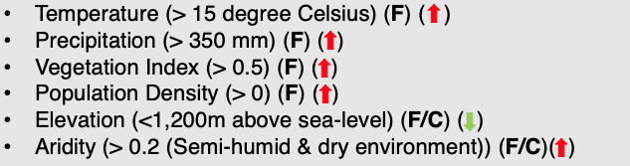
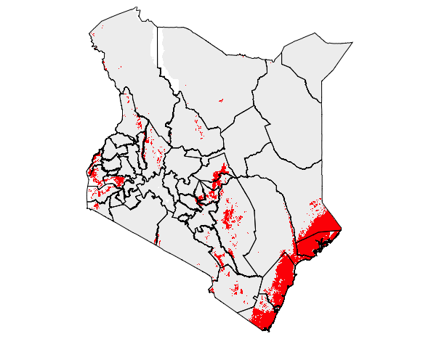
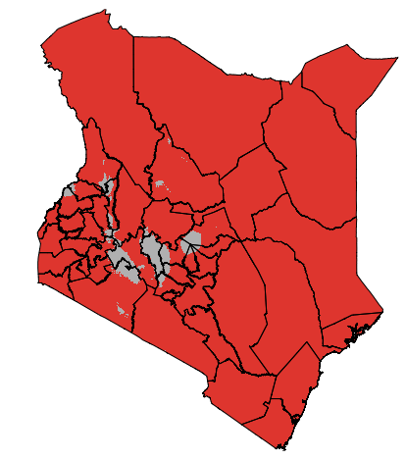
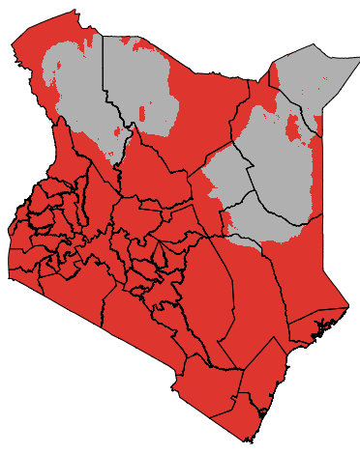
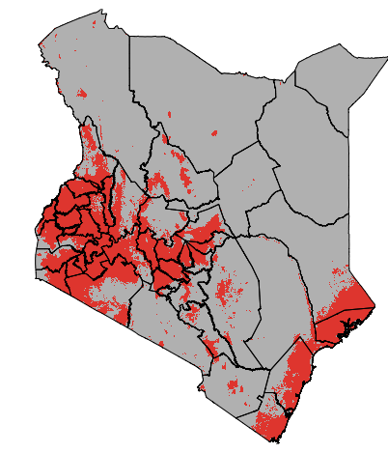
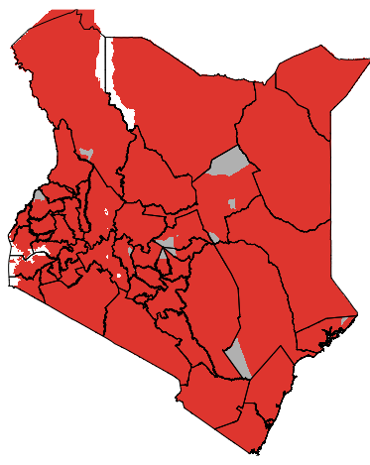
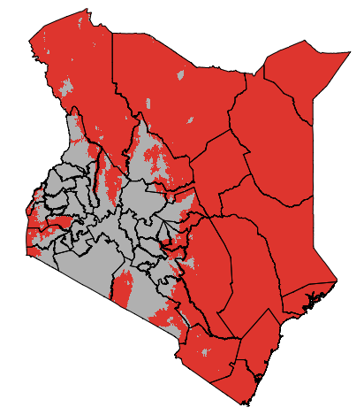
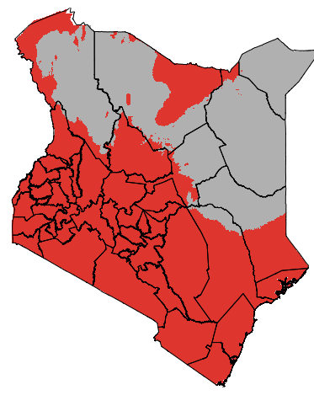





Binary (or Boolean) maps with the factor layers
Binary suitability is determined simply by multiplying the six individual layers that were reclassified to 0’s and 1’s.
Let’s look more into the reclassification part in the next slide!
NOTES
We have these data as raster – for this approach requires simply reclassification of the data into binary raster and multiplication
e.g., if temperature > 15 then change pixel value to 1 (good condition), else change to zero (bad condition)
$$×$$
$$×$$
$$×$$
$$×$$
$$×$$
$$=$$
13

Slide 14
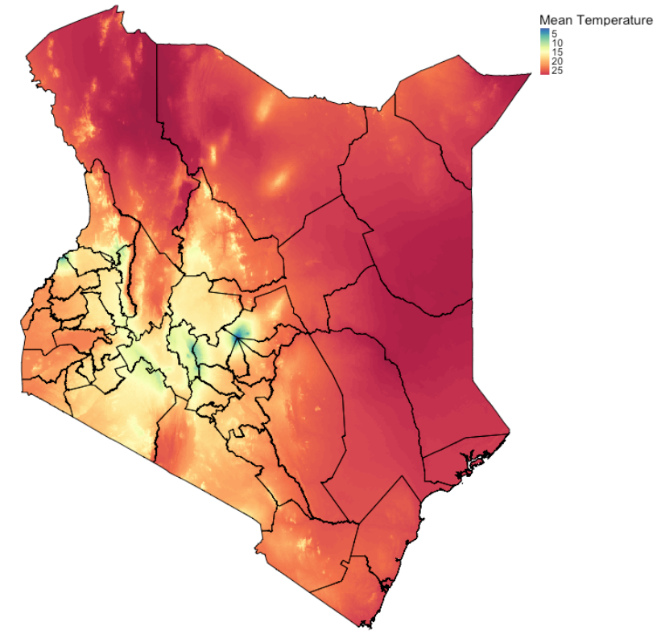
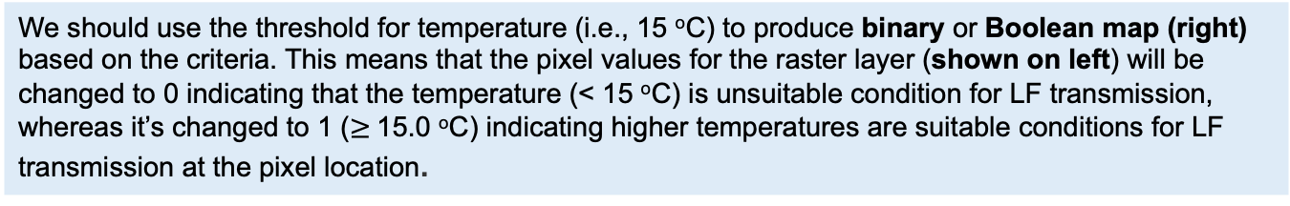

Reclassification of raster data
NOTES
Original: Mean Temperature (ºC)
Reclassified: (0 = Grey) < 15.0 (ºC)
(1 = Red) $≥$ 15.0 (ºC)
We should use the threshold for temperature (i.e., 15 ºC) to produce binary or Boolean map (right) based on the criteria. This means that the pixel values for the raster layer (shown on left) will be changed to 0 indicating that the temperature (< 15 ºC) is unsuitable condition for LF transmission, whereas it’s changed to 1 ($≥$15.0 ºC) indicating higher temperatures are suitable conditions for LF transmission at the pixel location.
14

Slide 15












Binary: Multiplicative case
$$×$$
$$×$$
$$×$$
$$×$$
$$×$$
$$=$$
1
1
1
1
1
1
1
$$×$$
$$×$$
$$×$$
$$×$$
$$×$$
$$=$$
Suitable
0
1
0
1
0
1
1
$$×$$
$$×$$
$$×$$
$$×$$
$$×$$
$$=$$
Not Suitable
15

Slide 16
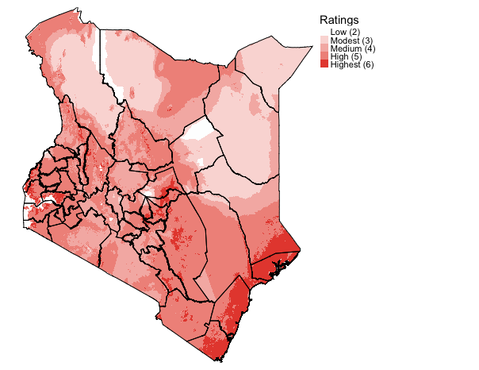





Rankings/Ratings maps with the factor layers
The ratings or suitability scores are determined simply by summing the values across the six individual layers that where reclassified (minimum value = 2, and maximum = 6).
NOTES
We have these data as raster – for this approach requires simply reclassification of the data into binary raster and summation to get scores
e.g., if temperature > 15 then change pixel value to 1 (good condition), else change to zero (bad condition)
$$+$$
$$+$$
$$+$$
$$+$$
$$+$$
$$=$$
16

Slide 17










Binary: Additive case
$$+$$
$$+$$
$$+$$
$$+$$
$$+$$
$$=$$
6
1
1
1
1
1
1
$$+$$
$$+$$
$$+$$
$$+$$
$$+$$
$$=$$
Highest score
4
1
0
1
0
1
1
$$+$$
$$+$$
$$+$$
$$+$$
$$+$$
$$=$$
Medium score
17

Slide 18
Boolean versus Ratings map:
Both approaches are accessible and are very great for rapid and descriptive analysis for the potential areas for LF suitability
However, the maps with ratings/score provides more details with regards to the intensity of LF suitability
Both maps have major issues:
Does not take in to account the fact that certain variables have more importance (or dominance) in terms of influence over other variables. For instance: LF (highest importance – precipitation >> population density >> vegetation – least importance)
NOTES
NOTE 1: We can do this by applying weights to each variable in order to show level of importance for the MCDA process. This approach is referred to as Saaty’s Analytical Hierarchy Process (AHP)
18

Slide 19
The Beginning: Introduction to Spatial Analysis and Data Science
Analytical Hierarchy Process (AHP)
19

Slide 20
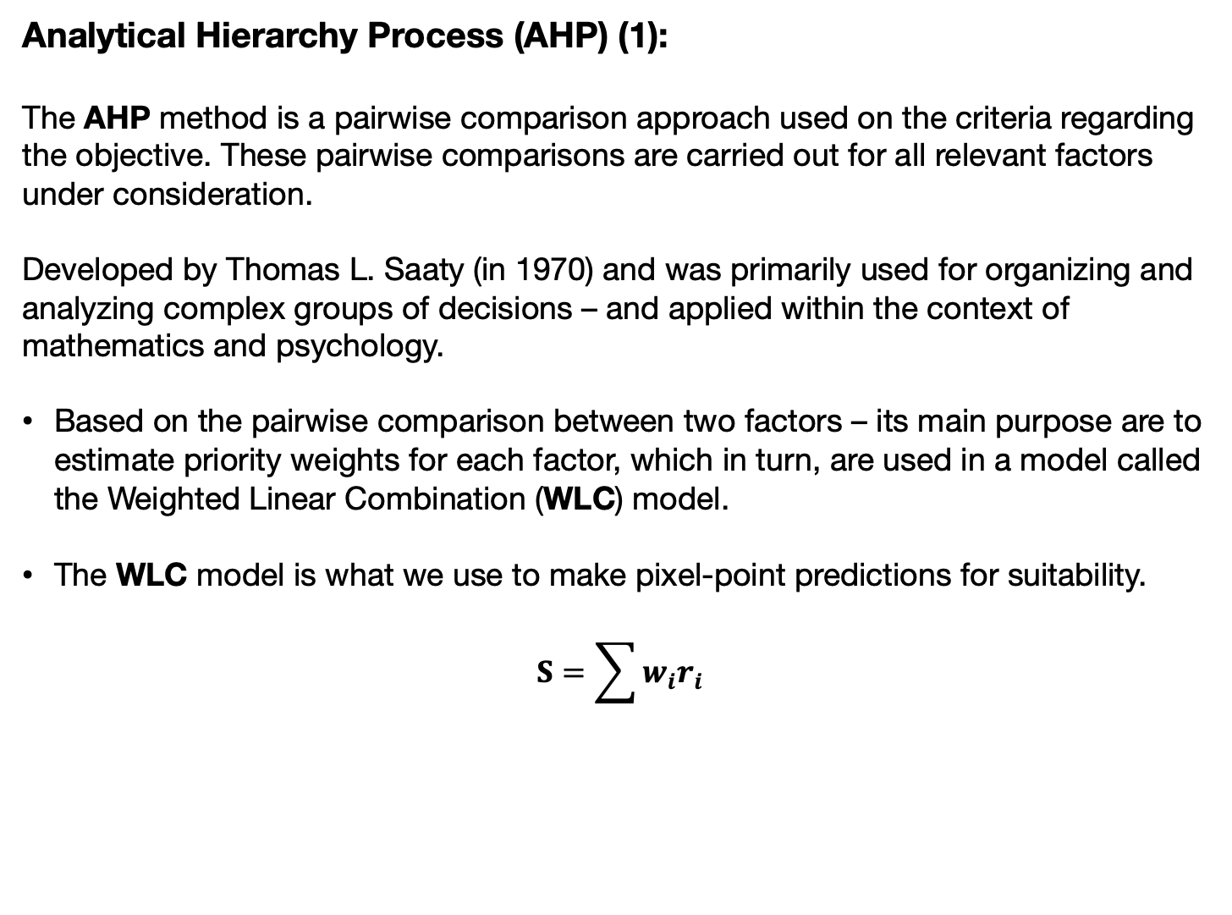
Analytical Hierarchy Process (AHP) (1):
The AHP method is a pairwise comparison approach used on the criteria regarding the objective. These pairwise comparisons are carried out for all relevant factors under consideration.
Developed by Thomas L. Saaty (in 1970) and was primarily used for organizing and analyzing complex groups of decisions – and applied within the context of mathematics and psychology.
Based on the pairwise comparison between two factors – its main purpose are to estimate priority weights for each factor, which in turn, are used in a model called the Weighted Linear Combination (WLC) model.
The WLC model is what we use to make pixel-point predictions for suitability.
$$S=\sum{w_{i}r_{i}}$$
NOTES
Important note: This approach is very easy – the most difficult part is performing the pairwise comparison where you must make a judgement about which variables in question to determine its importance over the others. Here, it requires you to have knowledge about the such phenomena or carried out some extensive literature review as well as seeking expert opinion from experts on the matter!
20

Slide 21
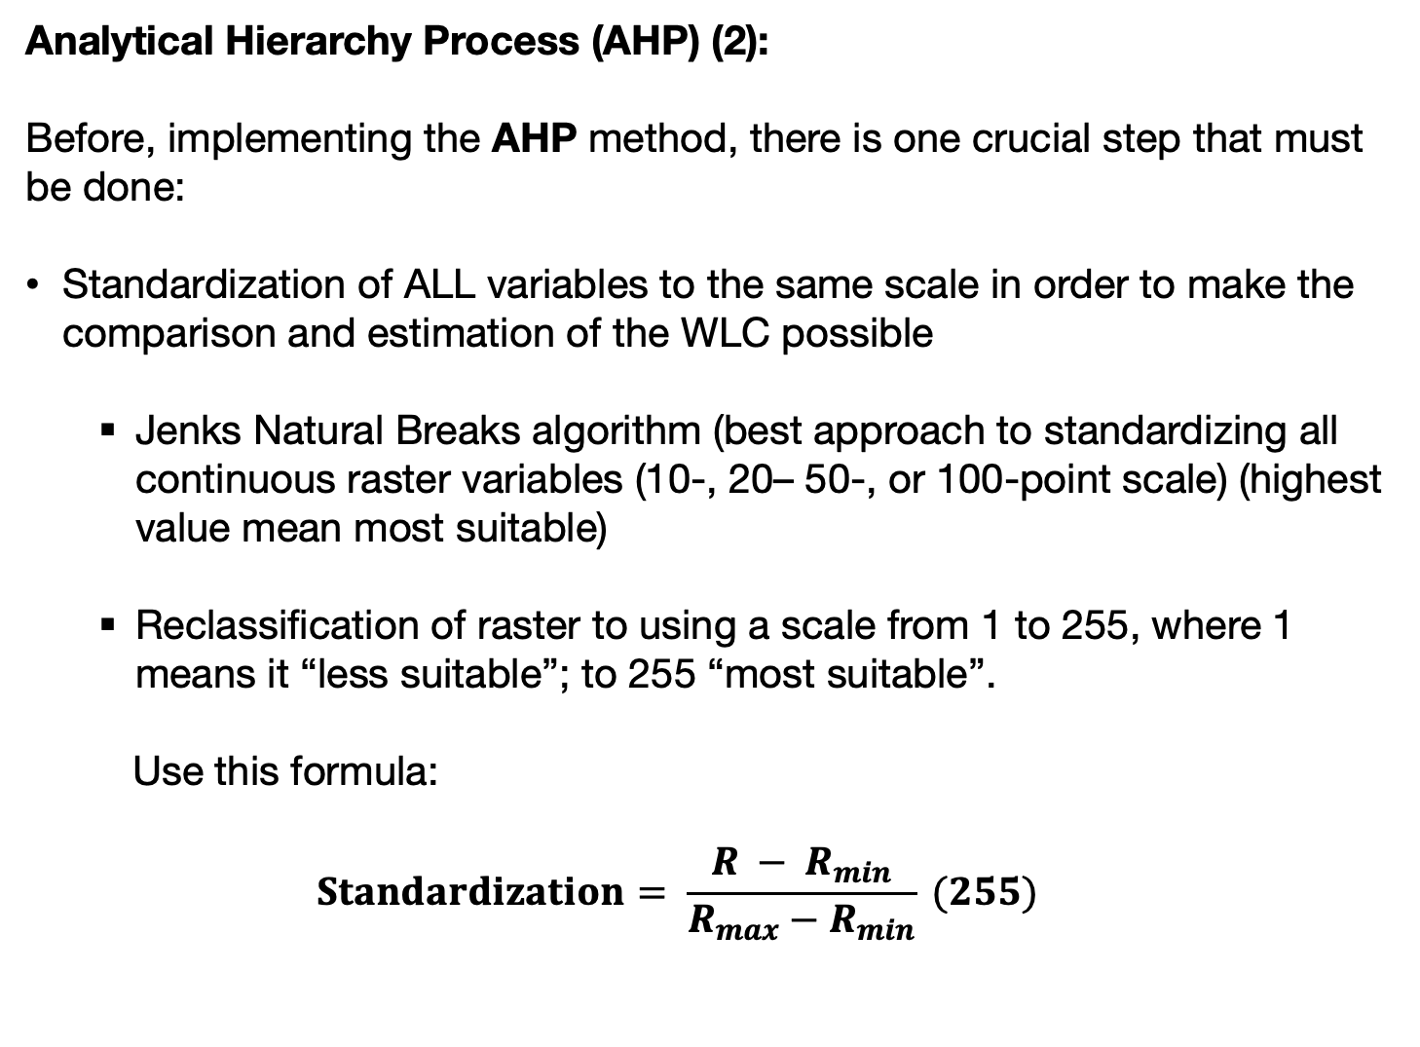
Analytical Hierarchy Process (AHP) (2):
Before, implementing the AHP method, there is one crucial step that must be done:
Standardization of ALL variables to the same scale in order to make the comparison and estimation of the WLC possible
Jenks Natural Breaks algorithm (best approach to standardizing all continuous raster variables (10-, 20– 50-, or 100-point scale) (highest value mean most suitable)
Reclassification of raster to using a scale from 1 to 255, where 1 means it “less suitable”; to 255 “most suitable”.
Use this formula:
$$Standardization= \frac{R − R_{min}}{R_{max}−R_{min}} (255)$$
NOTES
NOTE 1: Jenks is the best because it calculates the optimum break points while seeking to minimize the variance within categories, and at the same time minimize variance again between categories.
The 255-point scale is just a simple transformation. In fact, if you want the scale to be up to 1, multiply it to 1. If you want this to be up to 10 – multiply this by 10 etc.
21

Slide 22
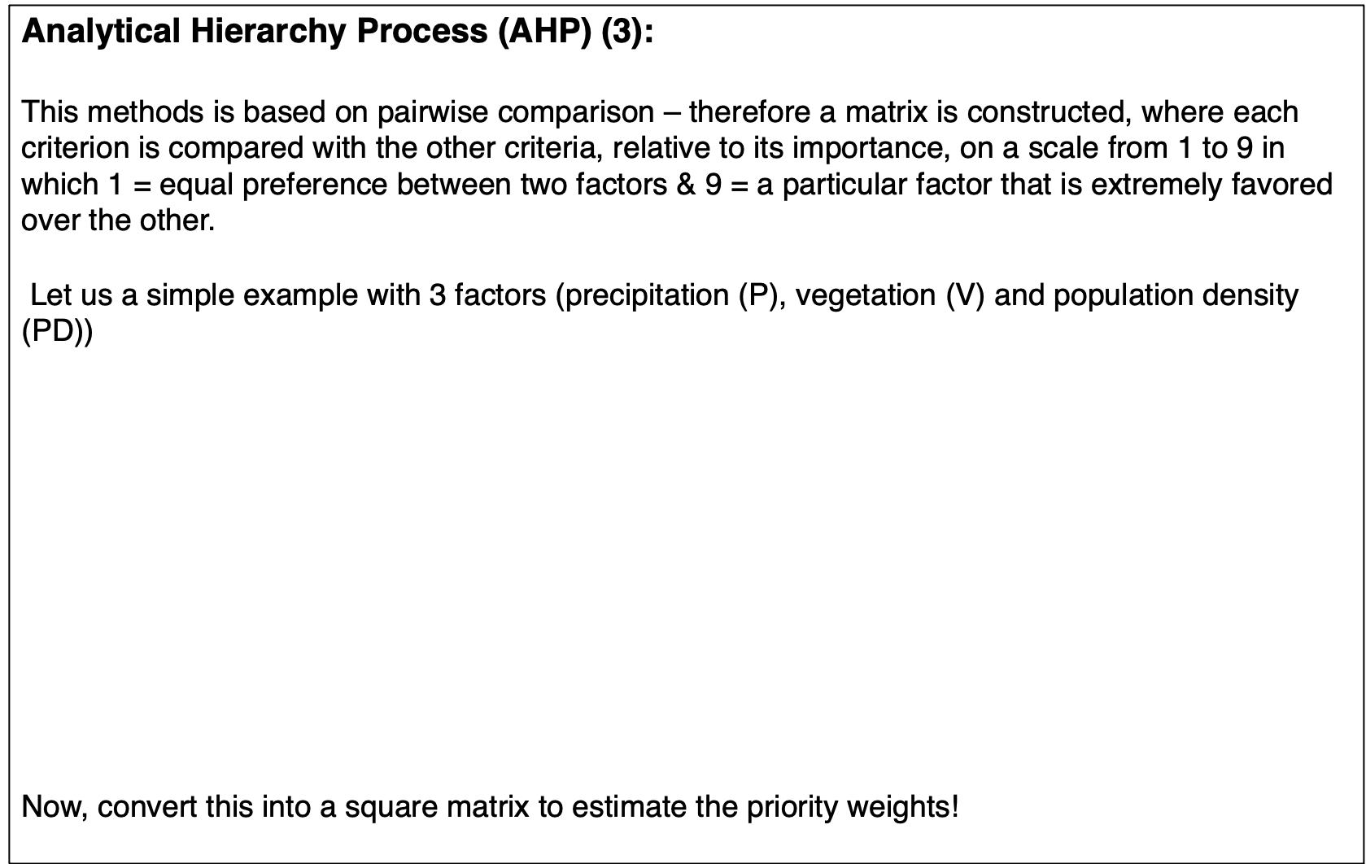
Analytical Hierarchy Process (AHP) (3):
This methods is based on pairwise comparison – therefore a matrix is constructed, where each criterion is compared with the other criteria, relative to its importance, on a scale from 1 to 9 in which 1 = equal preference between two factors & 9 = a particular factor that is extremely favored over the other.
Let us a simple example with 3 factors (precipitation (P), vegetation (V) and population density (PD))
Now, convert this into a square matrix to estimate the priority weights!
NOTES
NOTE 1: Create a pairwise table
NOTE 2: To know number of pairs is
= n(n-1)/2
= 3(2)/2
= 3 pairs
P,V
P,PD
V,PD
 | Extremely Favours (+VE) | Very Strong Favours (+VE) | Strongly Favours (+VE) | Slightly Favours (+VE) | Equal | Slightly favours (-VE) | Strongly favours (-VE) | Very Strong favours (-VE) | Extremely favours (-VE)
 | 9 | 7 | 5 | 3 | 1 | 3 | 5 | 7 | 9
P | X |  |  |  |  |  |  |  |  | V
P |  |  |  | X |  |  |  |  |  | PD
V |  |  |  |  |  |  | X |  |  | PD
Note 3: Interpretation are as follows
P,V = +9, based on judgement and what we know, we have assigned a highest preference for precipitation over vegetation
P,PD = +3, Slight preference for precipitation over population density.
V,PD = -5, the preference is going against vegetation and is strongly in favour of population density instead.
22

Slide 23
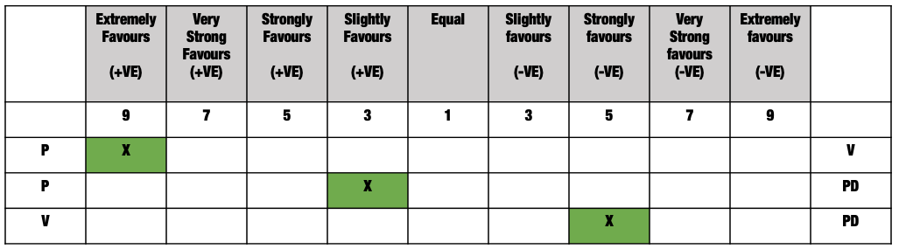
Analytical Hierarchy Process (AHP) (4):
Since we are dealing with 3 factors (three variables) in this example – we use the information from the pairwise table to create a 3-by-3 square matrix.
NOTES
Note 1: Interpretation are as follows
P,V = +9, based on judgement and what we know, we have assigned a highest preference for precipitation over vegetation
P,PD = +3, Slight preference for precipitation over population density.
V,PD = -5, the preference is going against vegetation and is strongly in favour of population density instead.
Note 2:
V,PD = -5, the preference is going against vegetation and is strongly in favour of population density instead. This is reciprocal (1/5)
 | P | V | PD
P | 1 | 9 | 3
V |  | 1 | 1/5
PD |  |  | 1
23

Slide 24
Analytical Hierarchy Process (AHP) (5):
Since we are dealing with 3 factors (three variables) in this example – we use the information from the pairwise table to create a 3-by-3 square matrix.
NOTES
Note 1: Interpretation are as follows
P,V = +9, based on judgement and what we know, we have assigned a highest preference for precipitation over vegetation
P,PD = +3, Slight preference for precipitation over population density.
V,PD = -5, the preference is going against vegetation and is strongly in favour of population density instead.
Note 2:
V,PD = -5, the preference is going against vegetation and is strongly in favour of population density instead. This is reciprocal (1/5)
 | P | V | PD
P | 1 | 9 | 3
V | 1/9 | 1 | 1/5
PD | 1/3 | 5 | 1
How to populate the matrix, and prepare to simple matrix calculations
For V,P we take the value for P,V and use the reciprocal = 9 to 1/9
For PD,P we take the value for P,PD and use the reciprocal = 3 to 1/3
For PD,V we take the value for V,PD and use the reciprocal = 1/5 to 5
We need to normalize the matrix and calculate the weights (i.e., priority weights) for the WLC model
24

Slide 25
Analytical Hierarchy Process (AHP) (6):
Normalization and weight calculations (1):
NOTES
 | P | V | PD
P | 1 | 9 | 3
V | 1/9 | 1 | 1/5
PD | 1/3 | 5 | 1
SUMS | 1.444 | 15 | 4.20
 | P | V | PD
P | 1/1.444 | 9/15 | 3/4.20
V | (1/9)/1.444 | 1/15 | (1/5)/4.20
PD | (1/3)/1.444 | 5/15 | 1/4.20
SUMS | 1.444 | 15 | 4.20
We need to normalize the matrix and calculate the weights (i.e., priority weights) for the WLC model
Take the column sums first
Then normalise the cell value by dividing it by its correspond column total.
25

Slide 26
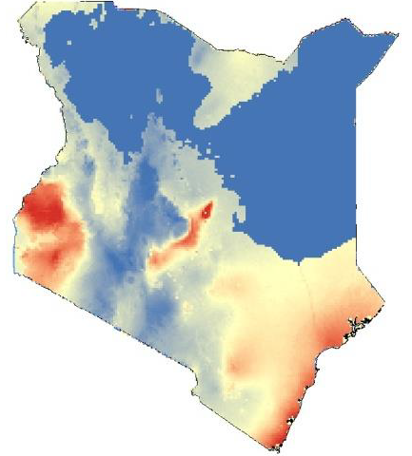
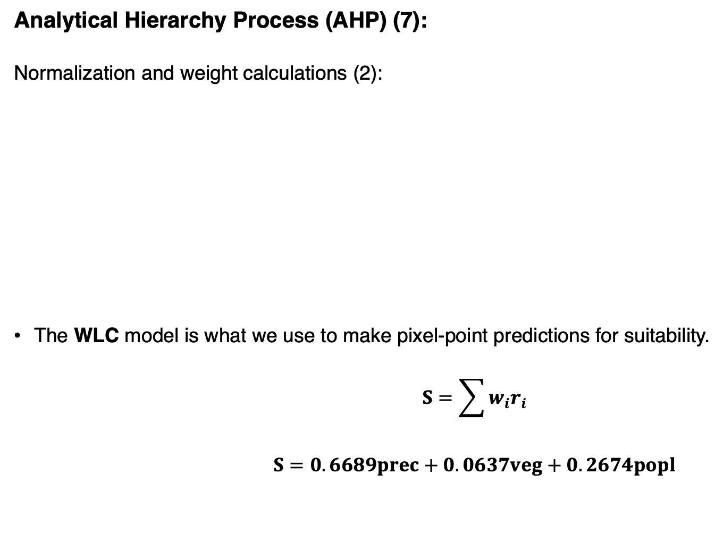
Analytical Hierarchy Process (AHP) (7):
Normalization and weight calculations (2):
The WLC model is what we use to make pixel-point predictions for suitability.
$$S=\sum{w_{i}r_{i}}$$
$$S=0.6689prec+0.0637veg+0.2674popl$$
NOTES
 | P | V | PD
P | 1/1.444 | 9/15 | 3/4.20
V | (1/9)/1.444 | 1/15 | (1/5)/4.20
PD | (1/3)/1.444 | 5/15 | 1/4.20
SUMS | 1.444 | 15 | 4.20
 | P | V | PD | Priority Weights
P | 0.6923 | 0.6000 | 0.7143 | (0.6923+0.6+0.7143)/3 = 0.6689
V | 0.0769 | 0.0667 | 0.0476 | (0.0769+0.0667+0.0476)/3 = 0.0637
PD | 0.2308 | 0.3333 | 0.2381 | (0.2308+0.3333+0.2381) = 0.2674
SUMS | 1.444 | 15 | 4.20
Then normalise the cell value by dividing it by its correspond column total.
Finally, for the normalised matrix, calculate the average to estimate the priority weights for the WLC model. IMPORTANT NOTE: The weights when summed should equal to 1 (or approximately close to 1 like 0.99XXX), if not, then there is a mistake somewhere in the calculations!
Suppose (on a scale 1 to 10) - Precipitation = 7, Vegetation = 2 and Population Density = 5
Suitability LF = 0.6689(7) + 0.0637(2) + 0.2674(5) = 6.146 (Medium suitability for LF)
Let talk a little about what’s happening with this equation in the next slide!
26

Slide 27

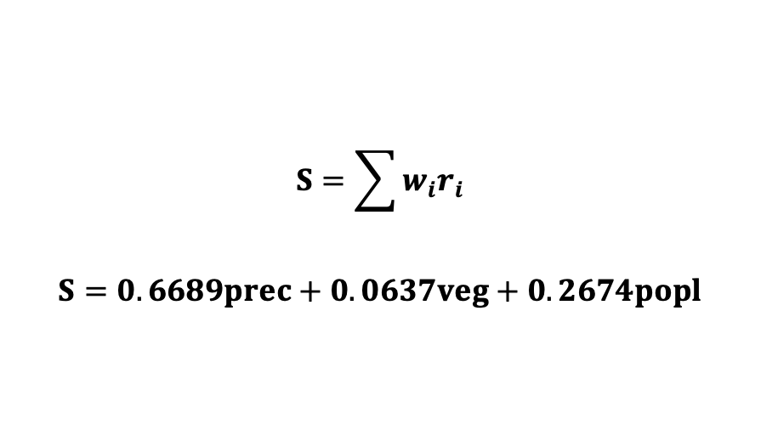



Weighted Linear Combination equation
NOTES
Note 1: This section is to show what is happening with the estimated weights and our rasters. The weights are multiplied against our scaled rasters, which are then summed on a corresponding pixel-by-pixel-ish way.
$$S=\sum{w_{i}r_{i}}$$
$$S=0.6689prec+0.0637veg+0.2674popl$$
Suppose (on a scale 1 to 10) - Precipitation = 7, Vegetation = 2 and Population Density = 5
Suitability LF = 0.6689(7) + 0.0637(2) + 0.2674(5) = 6.146 (Medium suitability for LF)
Precipitation
Vegetation
Population Density
Suitability Map
7
5
2
3
5
4
$$=$$
6.146
4.605
0.6689 $×$
$+$0.0637 $×$
$+$0.2674 $×$
4
3
3
5
6
3
4.471
3.127
27

Slide 28
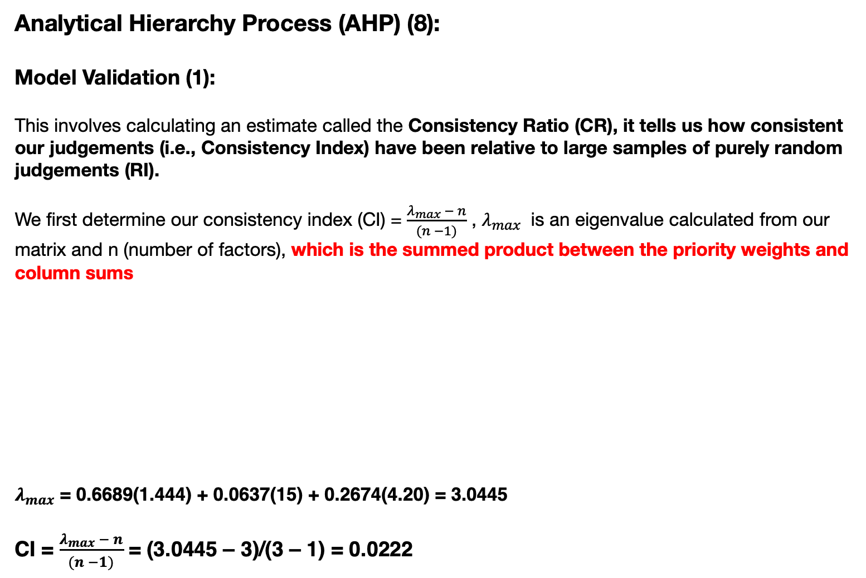

Analytical Hierarchy Process (AHP) (8):
Model Validation (1):
This involves calculating an estimate called the Consistency Ratio (CR), it tells us how consistent our judgements (i.e., Consistency Index) have been relative to large samples of purely random judgements (RI).
We first determine our consistency index (CI) = $\frac{λ_{max} − n}{(n −1)}$ , $λ_{max}$ is an eigenvalue calculated from our matrix and n (number of factors), which is the summed product between the priority weights and column sums
$λ_{max}$ = 0.6689(1.444) + 0.0637(15) + 0.2674(4.20) = 3.0445
CI = $\frac{λ_{max} − n}{(n −1)}$ = (3.0445 – 3)/(3 – 1) = 0.0222
NOTES
28

Slide 29
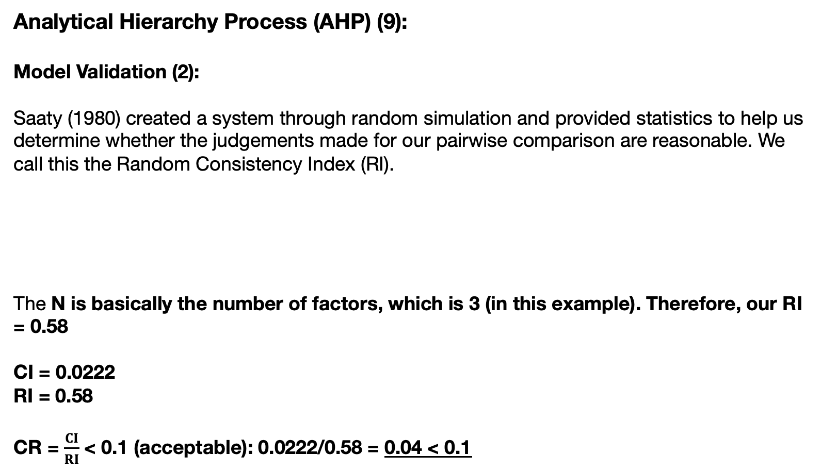
Analytical Hierarchy Process (AHP) (9):
Model Validation (2):
Saaty (1980) created a system through random simulation and provided statistics to help us determine whether the judgements made for our pairwise comparison are reasonable. We call this the Random Consistency Index (RI).
The N is basically the number of factors, which is 3 (in this example). Therefore, our RI = 0.58
CI = 0.0222
RI = 0.58
CR = $\frac{CI}{RI}$ < 0.1 (acceptable): 0.0222/0.58 = 0.04 < 0.1
NOTES
N | 1 | 2 | 3 | 4 | 5 | 6 | 7 | 8 | 9 | 10
RI | 0 | 0 | 0.58 | 0.9 | 1.12 | 1.24 | 1.32 | 1.41 | 1.45 | 1.49
Important note: If the CR > 0.1, then some pairwise values need to be reconsidered, and the process (pairwise comparison) is repeated until the desired value of CR < 0.1. There is some wiggle room for CR < 0.2 but generally the threshold is 0.1.
29

Slide 30
Summary
The take home message is:
Use this approach whenever you are in a data sparse situation (i.e., only have access to rasters, but no access to point process or geostatistical data is available)
Technique requires heavy use of expert knowledge – this is drawn from conducting a systematic, literature review. Surrounding your self with experts how can support you with building the criteria
Reclassification of raster grids to binaries for simple overlay maps for descriptive purposes
Knowledge-driven approach with the AHP
Mixed method approach (combination with qualitative and quantitative methodologies)
Construction of pairwise decision matrix, matrix standardization and estimation of Weighted Linear Combination Model (WLC)
Model Validation
30

Slide 31
GEOG0114: Course Evaluation & Student Feedback (Week 1-3)
https://forms.gle/R7R9DXoNTz9Qz4UD9
Dear Students,
As part of the Continuous Module Dialogue, we are conducting this survey to gauge the levels of student satisfaction with the learning experience in module GEOG0114: Principles of Spatial Analysis. We would like to receive your feedback, which would be greatly appreciated. This will help us make improvements to the course. The survey should only take up to 5 or 10 minutes, and your responses are completely anonymous.
Thank you,
Anwar and Justin.
31

Slide 32
Any questions?
32

